Slide 1

Big Data Roadmap Overview
Velocity Service Framework
November 2017

Slide 2
Agenda
What is it
How does it fit in to the customer journey
When to suggest this offering
Key Selling points
Limitations to be aware of
Timescales
Deliverables
Team Structure
Battlecard

Slide 3
What is it?
The Big Data Roadmap Offering provides a short term extensive discovery process covering the following areas:
Discover – working with business and technology leaders to identify and prioritize key use cases where big data can drive significant value across the organization.
Assess – the current technical and organizational landscape to determine “big data readiness” against best practices.
Recommend – provide architecture and organizational recommendations to execute on the priority business use cases.
Roadmap – map out your 12 month big data analytics roadmap to realize the identified business value.
This framework quickly helps an organisation understand the opportunity and guidance on where to start. It provides a robust set of deliverables to underpin next 12 months of investment for an organisation
Benefit to Think Big
This offering helps Think Big to engage over a long period of time and provides Think Big with a comprehensive oversight of the client’s aspirations and challenges. It also provides a mechanism to recommend and win further work. This offering can also be joined together as a joint offering with the Data Lake Foundation or RACE Discovery to helps spearhead the first use cases identified in the process. In this way, a Data Lake Foundation for instance, would follow on from a Roadmap but would be sold at the same time.

Slide 4
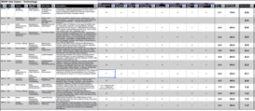
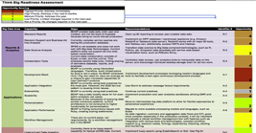
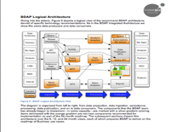
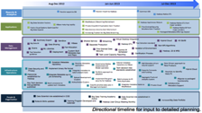
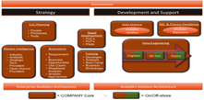
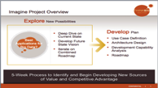
What is it?
Big Data Strategy
Readiness Analysis
Key Recommendations
Roadmap
“Where can Big Data drive value for my business? How can it unlock new services?”
“What is my current state technical and organizationally?”
“What market-leading technologies best fit my needs? How do I prepare my organization?”
“How do I take action now and over the next 12 months?”
Collaborative workshops across business lines
Identification and prioritization of high-value use cases
Gap analysis of current systems and organization against best practices
Initial prioritization of identified gaps
Phased Architecture recommendations
Phased Organizational Recommendations
Creation of 12-month roadmap based on priorities
Executive Presentation
Architecture Roadmap
12-Month Roadmap
Use Case Prioritization
Gap Analysis (Against Best Practices)
Capability Definition
Executive
Presentation

Slide 5
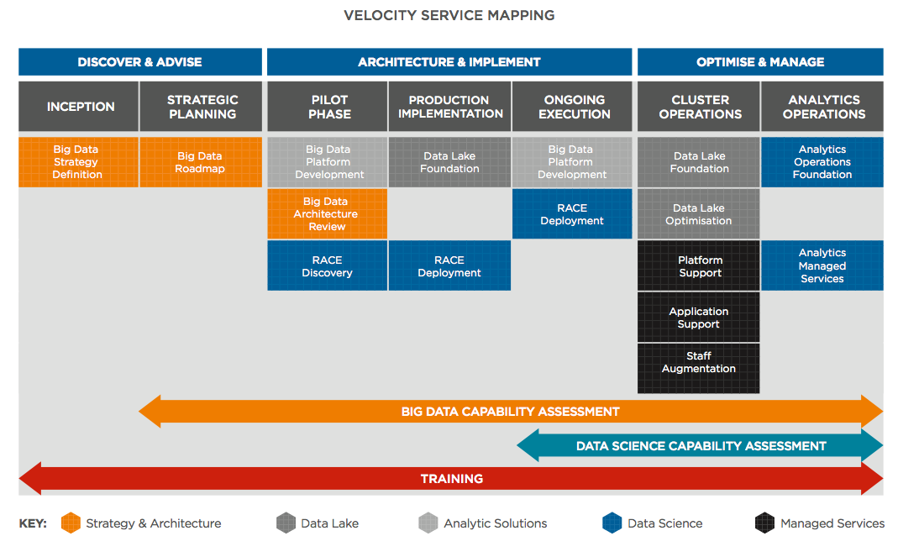
Where Does it fit into the Journey

Slide 6
When to suggest this offering?
This Offering is perfect for organisations that:
Are undertaking or considering a complex multi-year big data programme
Are at the start of the journey and want to make the right decisions
Think that they have a "big data opportunity", but need help identifying the focus areas/use cases.
Qualification Considerations
They have a big data strategy or at least know that they need a Big Data Implementation. If no then redirect to Big Data Roadmap offering which will help define a Big Data Strategy or Big Data Strategy Definition which will help them to understand we a big data strategy is important and get wider buy in.
They are clear on their long-term needs. If no then redirect to Big Data Strategy Definition offering as they probably haven’t even decided they need a big data strategy yet.
They are embarking on a strategic programme with C level sponsorship? If not then unlikely they will get budget for something like this. Big Data Strategy Definition offering may be an option to build interest with senior stakeholders.
They have $500k+ budget to build something production-grade

Slide 7
Target Audience
CEO
CIO
CTO (although less so)
Head of Analytics
CDO
CSO
Although this covers all aspects of the business, the overall Big Data Programme owner is the key target here.

Slide 8
Key Selling Points
When embarking on a strategic Big Data programme with aspirations on accessing multiple data sources and enabling many business units it can be difficult to understand where to start and at this point in the process, the risks are high of making the wrong decisions.
The Roadmap offering provides executives with a clear picture of the opportunities where big data analytics can drive value within your organization, and a prioritized roadmap to execute on the plan.
This is a full but quick engagement that ensure you start the journey on the right foot. Speed and Direction.

Slide 9
What Do You Get from a Roadmap?
Strategy & Prioritization
Alignment of key value drivers with technology planning
Prioritized use cases where Big Data Analytics drives value
Optional Use Case design using the Solution Planning and Design offering (separate)
12 Month Plan
Sequenced adoption of technologies against use case execution that provides quarterly value-defined milestones
Architecture Planning
Phased architectural recommendations to support early use cases and long-term growth plans
Capability Design
Recommendations and planning to make IT and business groups “Big Data” ready
© 2017 Think Big, A Teradata Company

Slide 10
In Summary
The output of this offering will deliver:
Prioritized list of uses cases where Big Data Analytics can drive significant business value created in collaboration with business stakeholders.
Key Architecture recommendations and roadmap to support the identified use cases.
Phased recommendations (based on best practices) on organizational structure initiatives to grow and maintain a thriving Big Data program.
12-month visual Big Data roadmap that layers use cases, technical delivery, and big data organizational initiatives.
Executive summary of findings and recommendations.

Slide 11
Prerequisites
All stakeholders are identified by Day 1.
All Workshop stakeholders are able to attend the use case Workshops in Weeks 1-2.
The customer must be able to assign a Project Owner who can remove roadblocks when issues are escalated.
It must be possible for the Customer Project Owner and Think Big Delivery Lead to mutually agree upon a Project schedule by Day 2.
The customer Project Owner is able to obtain the appropriate deliverable sign-off according to a mutually agreed-upon schedule.

Slide 12
Limitations to be aware of
To avoid confusion, please note the following about this offering:
The offering does NOT include a detailed design of a solution architecture
The offering does NOT include a detailed project plan for the subsequent phases
The offering does NOT include code-based deliverables
The offering is NOT a tactical offering it is a strategic offering
The offering does NOT include a review of the operational governance of data
The offering does NOT include a detailed evaluation of current-state skills and structure(s)
The offering does NOT include a detailed requirements or Epics and User Stories

Slide 13
Roadmap Engagement Timeline
Week 0 | Weeks 1-3 | Weeks 4-6 | Weeks 7-8
Project Prep and Planning
Use Case Workshops
Use Case Matrix
Big Data Road Map
Technical Deep Dives
Use Case Prioritization
Big Data Analytics Roadmap
Architecture and Capability Analysis
Architecture Definition
Architecture Definition
Report
Capability Definition
Capability Definition
Report
Executive Presentation
Client expectations should be set:
Minimum two weeks gap between receiving a PO and having a workshop based on resourcing constraints

Slide 14
Effort Breakdown
Role | Days
Principal Architect | 40
Senior/Principal Data Scientist | 10
Senior Delivery Lead | 30
QA (principal or above) | 8
Senior “Consultant” (engineer/DS/BC (depending on engagement) with document writing skills) | 15
Specialist Support (Ops, Security etc) | 5
QA - CSD must play some role in this if first engagement with the client
The Senior Consultant role can be played by either and engineer, data scientist, or industry consultant, depending on the engagement.
It is critical that the Senior Consultant role is played by someone who can write business facing documents.

Slide 15
Example of Workshop Attendees
Typically a number of interviews and workshops will be with the following stakeholders:
Business Units:
Executive Sponsor
BU(s) SVP's
BU(s) Manager
BU(s) Analytics "Champion"
BU(s) Data SME
Solution Architects
Technical Architects
Data Engineers
BI/DW Leads
Devops
Infrastructure team
Security

Slide 16
Expected Roadmap Deliverables
Deliverable | Description
Use Case Prioritization Matrix | Prioritized list of uses cases where Big Data Analytics can drive significant business value created in collaboration with business stakeholders.
Architecture Roadmap | Key Architecture recommendations and roadmap to support the identified use cases.
Capability Definition Report | Phased recommendations (based on best practices) on organizational structure initiatives to grow and maintain a thriving Big Data program.
Big Data Analytics Roadmap | 12-month visual Big Data Analytics roadmap that layers use cases, technical delivery, and big data organizational initiatives.
Executive Presentation | Executive summary of findings and recommendations.

Slide 17
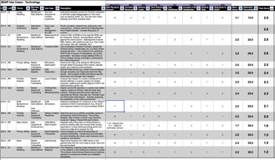
Discovery – Use Case Definition Report
Use Case Definition
Architecture Definition
Capability Definition
Roadmap & Recommendations
Focused workshops with business and technology units.
Where appropriate, 1-on-1’s with senior leaders to discuss business imperatives.
Identify overall list of use cases and business value levers.
Finalize scoring and ranking of use cases.
Review required data sources and access patterns for the identified use cases.
Notes:
READINESS NEEDS TO BE SPEED TO VALUE
REDO SOME IMAGES SO THAT THEY ARE WHOLE IMAGES, NOT JUST SCREENGRABS
TEST THE PRESENTATION ON A BIG SCREEN FOR FINAL TEST

Slide 18
Discovery Approach
Use Case Definition
Architecture Definition
Capability Definition
Roadmap & Recommendations
Prep
Pre-workshop questionnaires distributed
Results summarized and used as seed questions for workshops
Discover
Interactive, facilitated whiteboard brainstorming sessions & technical deep dives
One-on-one interviews with senior leadership to review top 3-5 business imperatives.
Validate
Digest, summarize, and validate workshop outcomes with stakeholders
Fill in any information gaps
Review data sets and access patterns for identified use cases
Prioritize
Collaboratively work to prioritize use cases
Review/vet with management
General:
Work Across Each Business Unit
Separate Tech & Business Discovery Tracks

Slide 19
Technical Deep Dives
Use Case Definition
Architecture Definition
Capability Definition
Roadmap & Recommendations
Discovery
For each technical area or use case:
Review data sets
Review current state architecture: infrastructure, data platforms, and applications
Review end-user access patterns / “way-of-working”
Assess current skills, tools & processes
Validate
Review initial recommendations
Follow-up
Fill in any information gaps

Slide 20
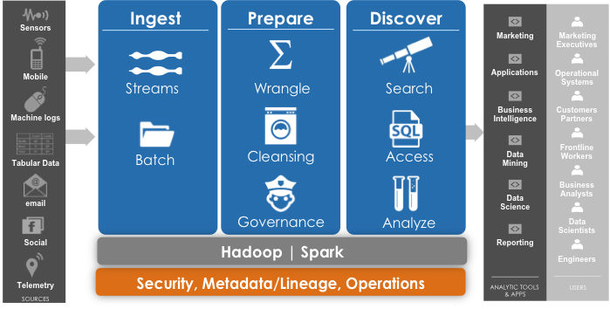
Architecture Definition
Use Case Definition
Architecture Definition
Capability Definition
Roadmap & Recommendations
Use prioritized use cases to identify patterns for technologies and platforms that drive Big Data ecosystems.
Lay out an architectural roadmap based on the prioritized use cases, leveraging Think Big’s reference architectures.
Identify key recommendations based on best practices.

Slide 21
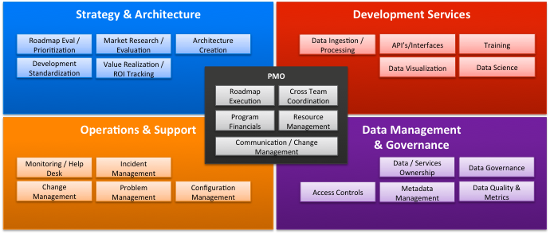
Capability Definition
Use Case Definition
Architecture Definition
Architecture & Capability Definitions
Capability Definition
Roadmap & Recommendations
Review existing big data organization structure against best practices
Identify areas that need to be built or enhanced.
Prioritize initiatives based on business imperatives and identified use cases.

Slide 22
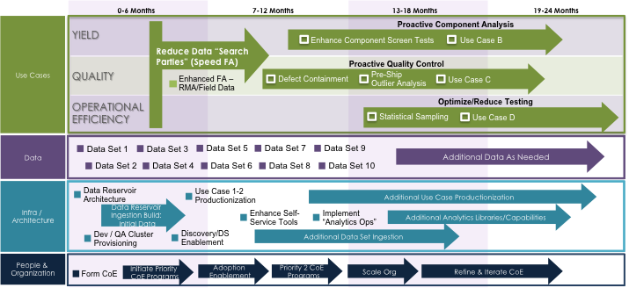
Roadmap & Recommendations
Use Case Definition
Architecture Definition
Capability Definition
Roadmap & Recommendations
Sequence use cases and supporting capabilities across 12 month Roadmap.
Develop recommended action plan, required investment and business justification.
Develop Executive Presentation.

Slide 23
Team (Role) Structure
Role | Role Description
Senior Delivery Lead | Responsible for ensuring that the client expectations are set, deliverables are on time and regular communications between client and Think Big are maintained. They will also coordinate reviews, workshops and interviews as well as help to co-run the use case brainstorming workshops. The Delivery Lead may also play a significant part in the write-up of documentation.
Principal Architect | This is typically an enterprise architect at principal level. They will help to shape the discussions and will lead the client facing engagements, providing thought leadership where appropriate. They will lead the workshops and interviews ensuring that all relevant information is obtained the client is engaged throughout the workshop contribute to the output write-up (typically the solution architecture pieces)
Senior/Principal Data Scientist | They will support the principal architect contributing to the deliverables, workshops and interviews with Data science related content. This for example could be validating the viability of use cases or providing thought leadership, such as advanced statistics and machine learning techniques over open source big data capabilities. Formulates recommendations on data science and analytics and owns the data science and analytics part of the architecture definition.
Senior Consultant | This role supports the team in workshops and contributes to the overall write-up of the deliverables. This will typically be senior/principal Data Scientist, Engineer or Industry Consultant that is comfortable leading client discussions and writing business related content.
QA | The Partner supports the overall engagement, engaging with exec sponsors in the proces, being part of exec presentations and providing QA support

Slide 24
Commercials
Base Price - $200,000 fixed price (USD)
This covers all aspects of the 8 week engagement
Please refer to the pricing guide for the base price for other countries
Payment Schedule
Milestone | $Amount ($200k) | Weeks from Project KO
SOW Signature | $40k | 0
Use Case Matrix | $40k | 3
Capability Definition | $40k | 7
Architecture Roadmap Document | $40k | 7
Final Presentation | $40k | 8

Slide 25
Battlecards
This is a lot of money to spend on planning and assessment when we haven’t even started
Make the right choices about which use cases, what technology and which capabilities to tackle first is crucial and the cost of making the wrong decision will far outweigh the cost of this offering. If you would like a lighter offering then there is BDCA, Architecture Review and Strategy Definition depending on your chosen focus area.
We know our business and what we need. Why do we need consultants to tell us that
Whilst each and every part of your business expertise in their chosen area, bringing everything together and combining this with expert knowledge on Big Data delivery is key. We will leverage all of that knowledge and harness it into a joined up strategy and roadmap that makes sense for everyone.

